Slide 1
Cycle to Cycle Clustering preliminary report
Shuheng Liu

Slide 2
Motivation
In TCCIII engine data set, hundreds of cycles are measured, including flow feature evolution and pressure signal.
Is there a way to sort out flow features into groups so that we can simplify the description?
How can we find out the most and the least deviated cycle? Can deviation of cycles be quantified?
Can flow feature be predicted by just monitoring pressure signal?

Slide 3
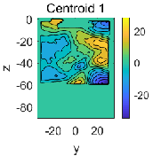
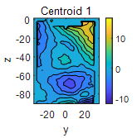
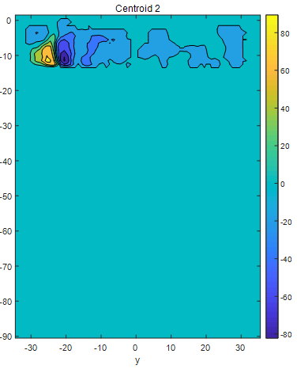
Idea to answer
-Every black dot is a flow feature, in clustering, we call it centroid.
-Every cycle can be represented by a line path in the network, for instance, the red line path.
possible flow features
Discritization in flow feature
crank angle/ time
-The simplification comes from discritization in both time and flow feature
Discritization in time

Slide 4
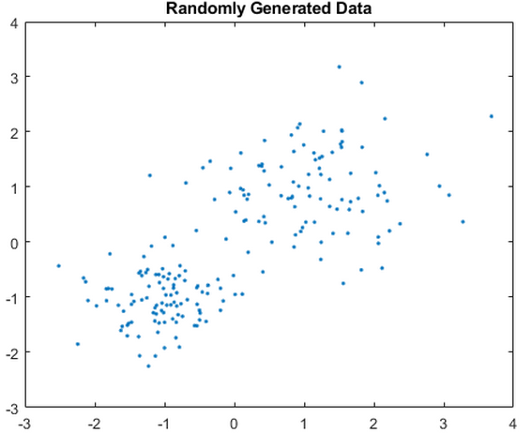
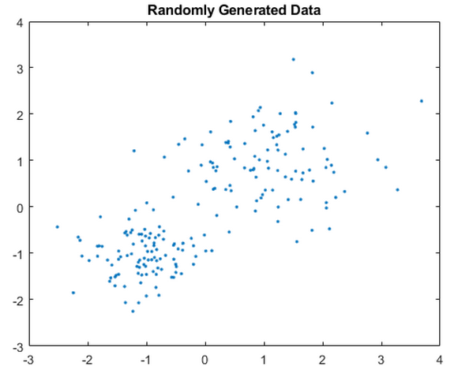
How to get the discritized flow features(black dots)
Through unsupervised machine learning techniques: Clustering
Widely used clustering techniques: kmeans, spectral clustering
Function: Assign flow features to clusters and derive the centroid of each cluster.
For example, in 2D space, there are a bunch of data points(Flow features are just data points in very high dimension), scattered in an xy coordinate system, these data can be put into 2 or 3 clusters. Number of clusters can be decided by users.

Slide 5
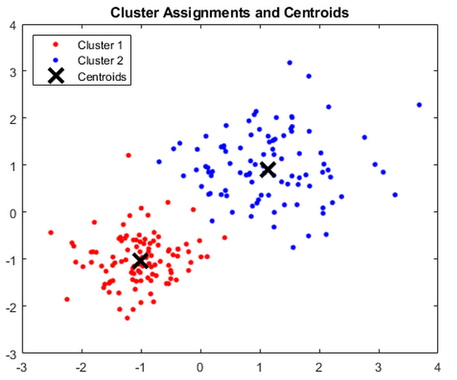
How to get the discritized flow features(black dots)
-After kmeans, resulting clusters and centroids are shown below:

Slide 6
How to quantify the deviation of centroids
After clustering on all the flow features at interesting crank angles, there is a probability distribution for every interesting crank angle θ₁,θ₂,...,θ_{Nθ}, recorded by a probability distribution vector . For example, y_{i1} is number of flow features in cluster1, normalized by total number of flow features at i th interesting crank angle.
To quantify how much centroid j deviates from mean of crank angle i, we compute distance h_{ji} between y_{i} and the exact distribution, for example .
possible flow features
deviation
crank angle/ time
crank angle/ time

Slide 7
How to quantify deviation of cycles
-According to the line path of each cycle, a so-called distance evolving matrix H can be assembled:
-The ith row of H contains the h sequence of the i th cycle.
possible flow features
deviation
crank angle/ time
crank angle/ time
-The significance of H: H contains the deviation information of all the cycles in a much reduced order

Slide 8
Possible ways to investigate H
Just plot every or some of the row of H.
For example:
It may show the rough tendency of evolution, but may be too busy when number of cycles increase
Deviation
crank angle/ time

Slide 9
Possible ways to investigate H
-sum up every row of H to investigate the total deviation of every cycle. Associate every cycle with one value of deviation. The highest and lowest deviation cycles can be separated. High and low deviation cycles can be separated.
An example is shown below:
A self-decided boundary to separate high and low deviation cycles
highest deviation cycle
lowest deviation cycle

Slide 10
Possible ways to investigate H
Track cycles with high deviation at the begining
example:
deviation
Initial crank angle, label the cycles with high deviation
crank angle/ time
See how the interesting cycles evolve until the final crank angle.
high deviation
deviation
low deviation
number of cycles
number of cycles

Slide 11
Possible ways to investigate H
Compute transition probability
deviation
-Associate a transition probability distribution vector with every cluster except for the last crank angle
crank angle/ time

Slide 12
Implementation on real data
Input data: TCCIII, Fired, Full View, image plane x=0, common grid id:S_2014_02_13_02
Clustering algorithm: kmeans
crank angles:
Number of cluster for each crank angle:

Slide 13
Clusters

Slide 14
Clusters

Slide 15
Clusters

Slide 16
Clusters

Slide 17
Clusters

Slide 18
Clusters

Slide 19
Diagrams
Cycle 88 and 188 are randomly chosen. All the cycles can be visualized by a line pattern.

Slide 20
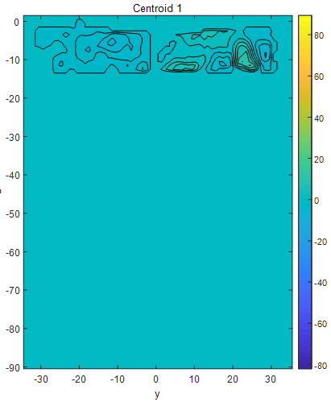
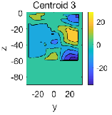
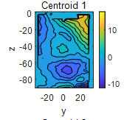
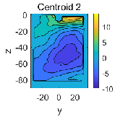
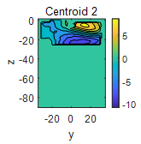
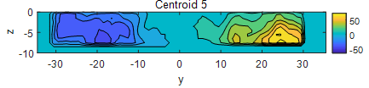
Further interpretation
We will know cycle 88, for example, go through clusters 1-3-1-2-2-5

Slide 21
Quantify deviation of centroids
-Every cluster is associated with a deviation value. Note the vertical axis change from cluster number to deviation.

Slide 22
Quantify deviation of cycles
-Cluster transition process of a cycle is replaced by a deviation sequence.

Slide 23
Overall view of quantification(Method 1 to investigate H)
-Both plots show the evolution of all cycles,
the first plot shows cluster transition, while
the second shows deviation sequence.
-In fact, the second plot contains all the information
about H (distance evolving matrix)

Slide 24
Investigate H (Method 2)
highest deviation cycle #46
Sum up every row of H and plot
High deviation cycles
Threshold to separate high and low deviation cycles
Low deviation cycles
lowest deviation cycle #10

Slide 25
Investigate H (Method 2)
See the deviation sequences of the highest and lowest deviation cycles.
Never touches lowest
Stay lowest

Slide 26
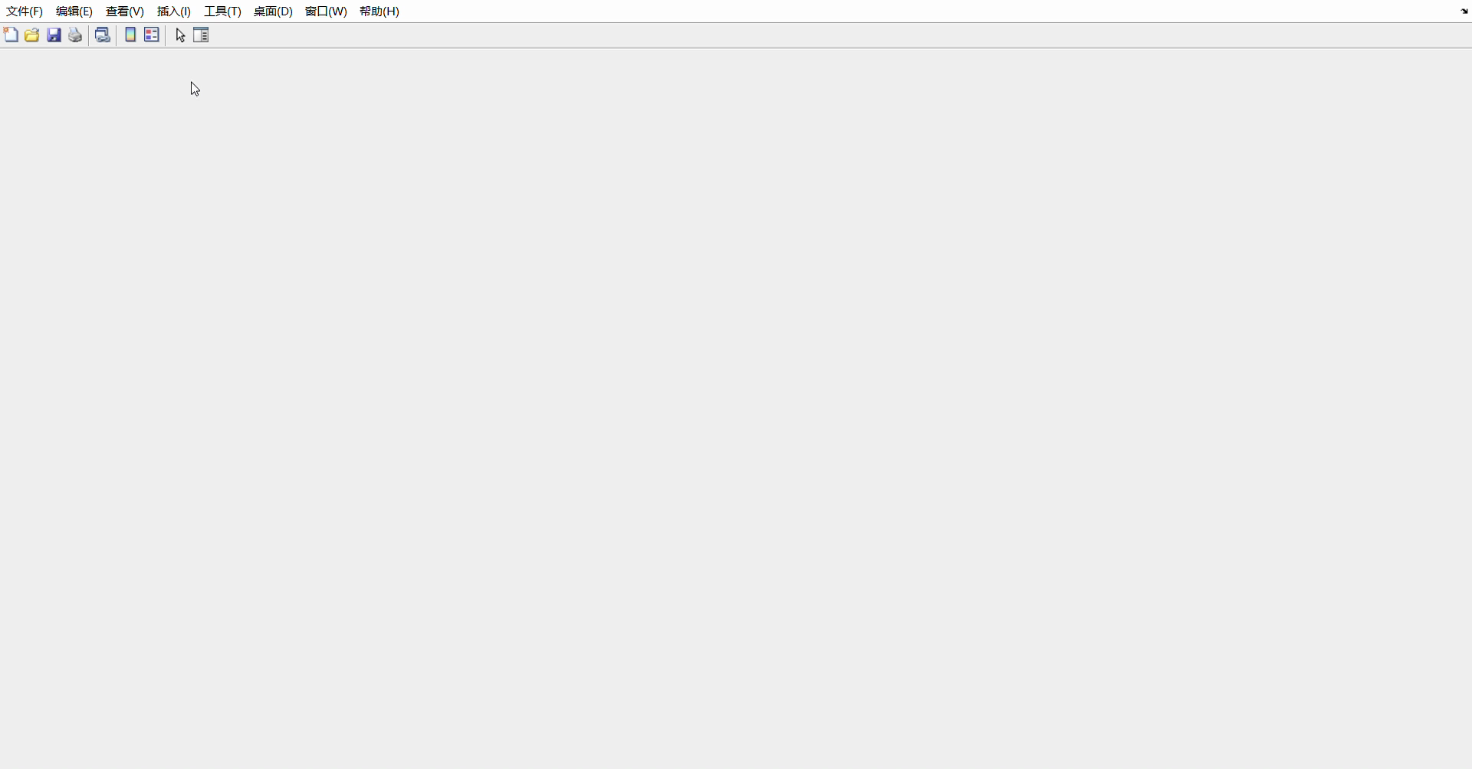
Investigate H (Method 2)
-We can visualize highest and lowest deviation cycles and compare.

Slide 27
Investigate H (Method 3)
Let's track cycles with high deviation at the beginning
-To find out whther high deviation at the beginning ends up with high deviation at the end
-If that is the case, the system could be unstable
-For this input data, that's not the case. None of the interesting cycles ends up with high deviation

Slide 28
Investigate H (Method 4)
Let's compute every probability of transition between clusters
In these cycles, they tend to transit to lower deviation. They may tend to go stable.

Slide 29
Relate to pressure signal
Since high and low deviation cycles are separated (Method 2 to investigate H), it is possible to find out whether their corresponding pressure signals are also separated.
From these two sensors, we see the separation
of pressure signal is obvious

Slide 30
Relate to pressure signal
-This sensor does not convey obvious separation between two groups of cycles.

Slide 31
Relate to pressure signal
-From thse two sensors, separation of pressure
signals is also obvious.
-It may be true that for this system, large deviation
in pressure indicates large deviation in flow feature.

Slide 32
Conclusion
An approach to simplify the description of similar cycles is proposed. It is realized by discretising time and clustering through flow features.
An idea to quantify deviation of flow features and cycles is derived afterwards. They are computed as distance between probability distributions.
Several methods to investigate the deviations are implemented, which may distinguish between high and low deviation cycles, reflect the tendency of variation and verify the stability of a system.
Pressure signals may indicate the deviation of flow features by studying regulation beforehand.

